Slide 1
Playtesting Report | Yiqing Ling
March 29th
Pangolin!
Protect or Poach?

Slide 2
Serious Goals
Gain knowledge of Pangolins, including features, threats and protection methods
Establish teenagers’ interests and improve their attention to pangolin
Target Audience
Chinese teenagers and all teenagers who live in China aged between 14 and 25

Slide 3
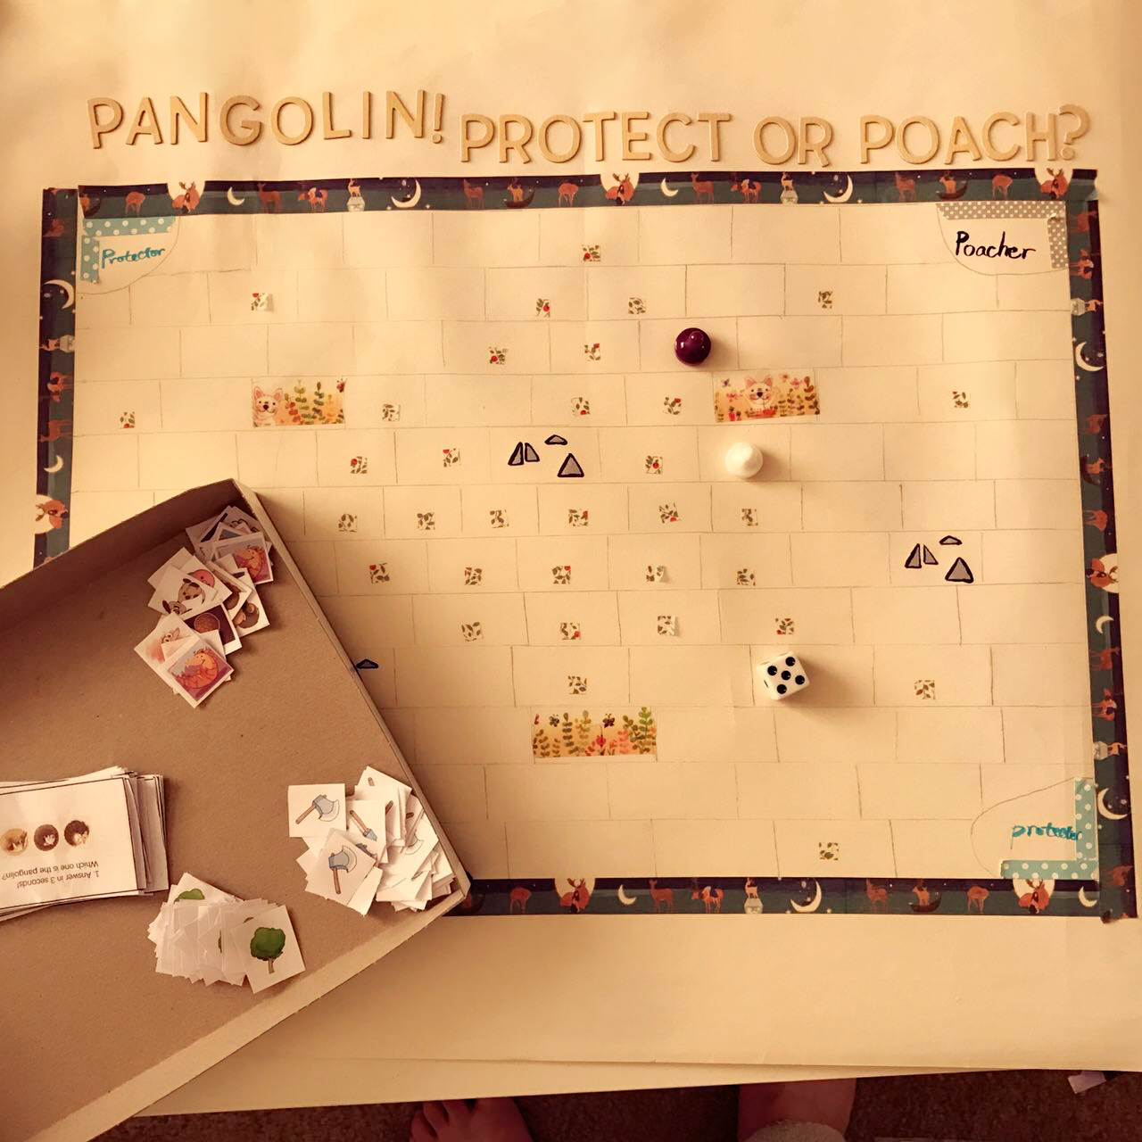
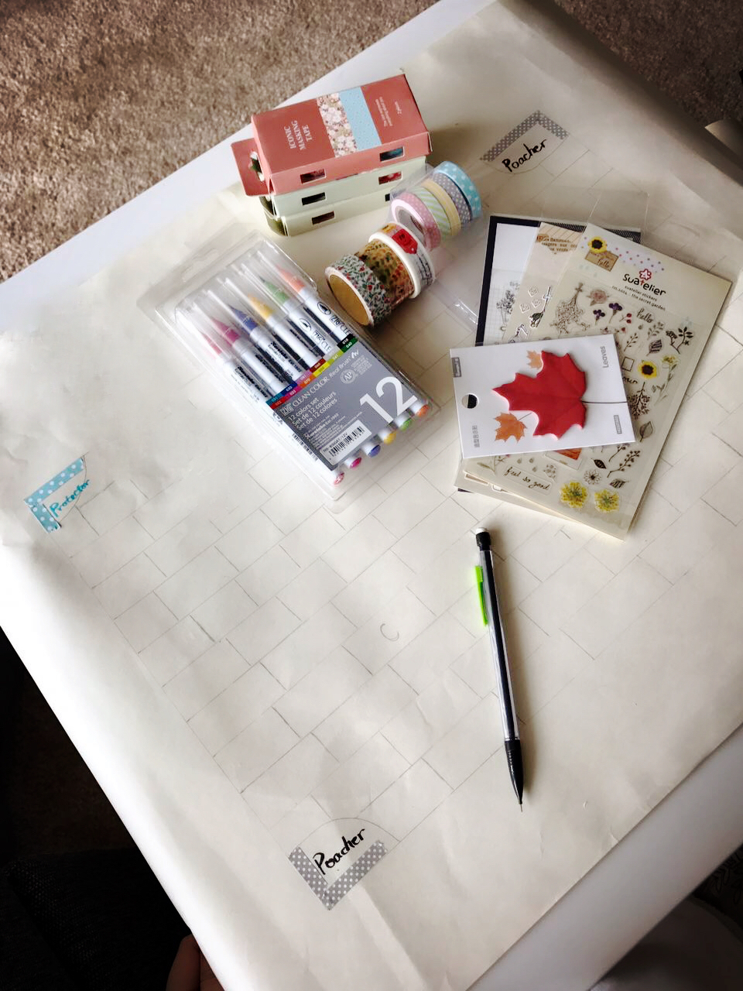
Game prototype

Slide 4
Game Instruction
1. Pick a role
Roll the dice to decide who plays the protector, and who plays the poacher
2. Place 20 unknown animal tokens (face down)
Each player place 10 tokens into any square which has a small mark without seeing the animal side
The lovely animal tokens include 15 pangolins and 5 other animals
3. Start the game
Each one has two start points to choose
4. End of the game
Remove all tokens in the map or play at most 20 turns
5. Game goal
The one who gets more pangolin tokens wins
6. Challenges
Roll a dice and land in squares with animal tokens
Answer the quiz card correctly to get the tokens
Protector: get to saplings areas and plant trees to slow down poachers
Poacher: get to camps areas and get axes to cut trees

Slide 5
Playtest Goals
I want to…
know whether the game rules is easy to learn
identify whether completing the game is too easy or too difficult
determine whether the prototype setting is appropriate, including the number of different elements
test whether the game is engaging and fun
understand how much the game can help for the serious goals

Slide 6
Playtest Questions
How long does the whole game take?
Do players feel engaged in the game?
Do the token rewards make sense?
Does the map size appropriate?
Does the number of tokens appropriate?
Does the number of fixed elements appropriate, such as # of trees.
What confusions they have during the game?
Anything about pangolin impresses or changes them?

Slide 7
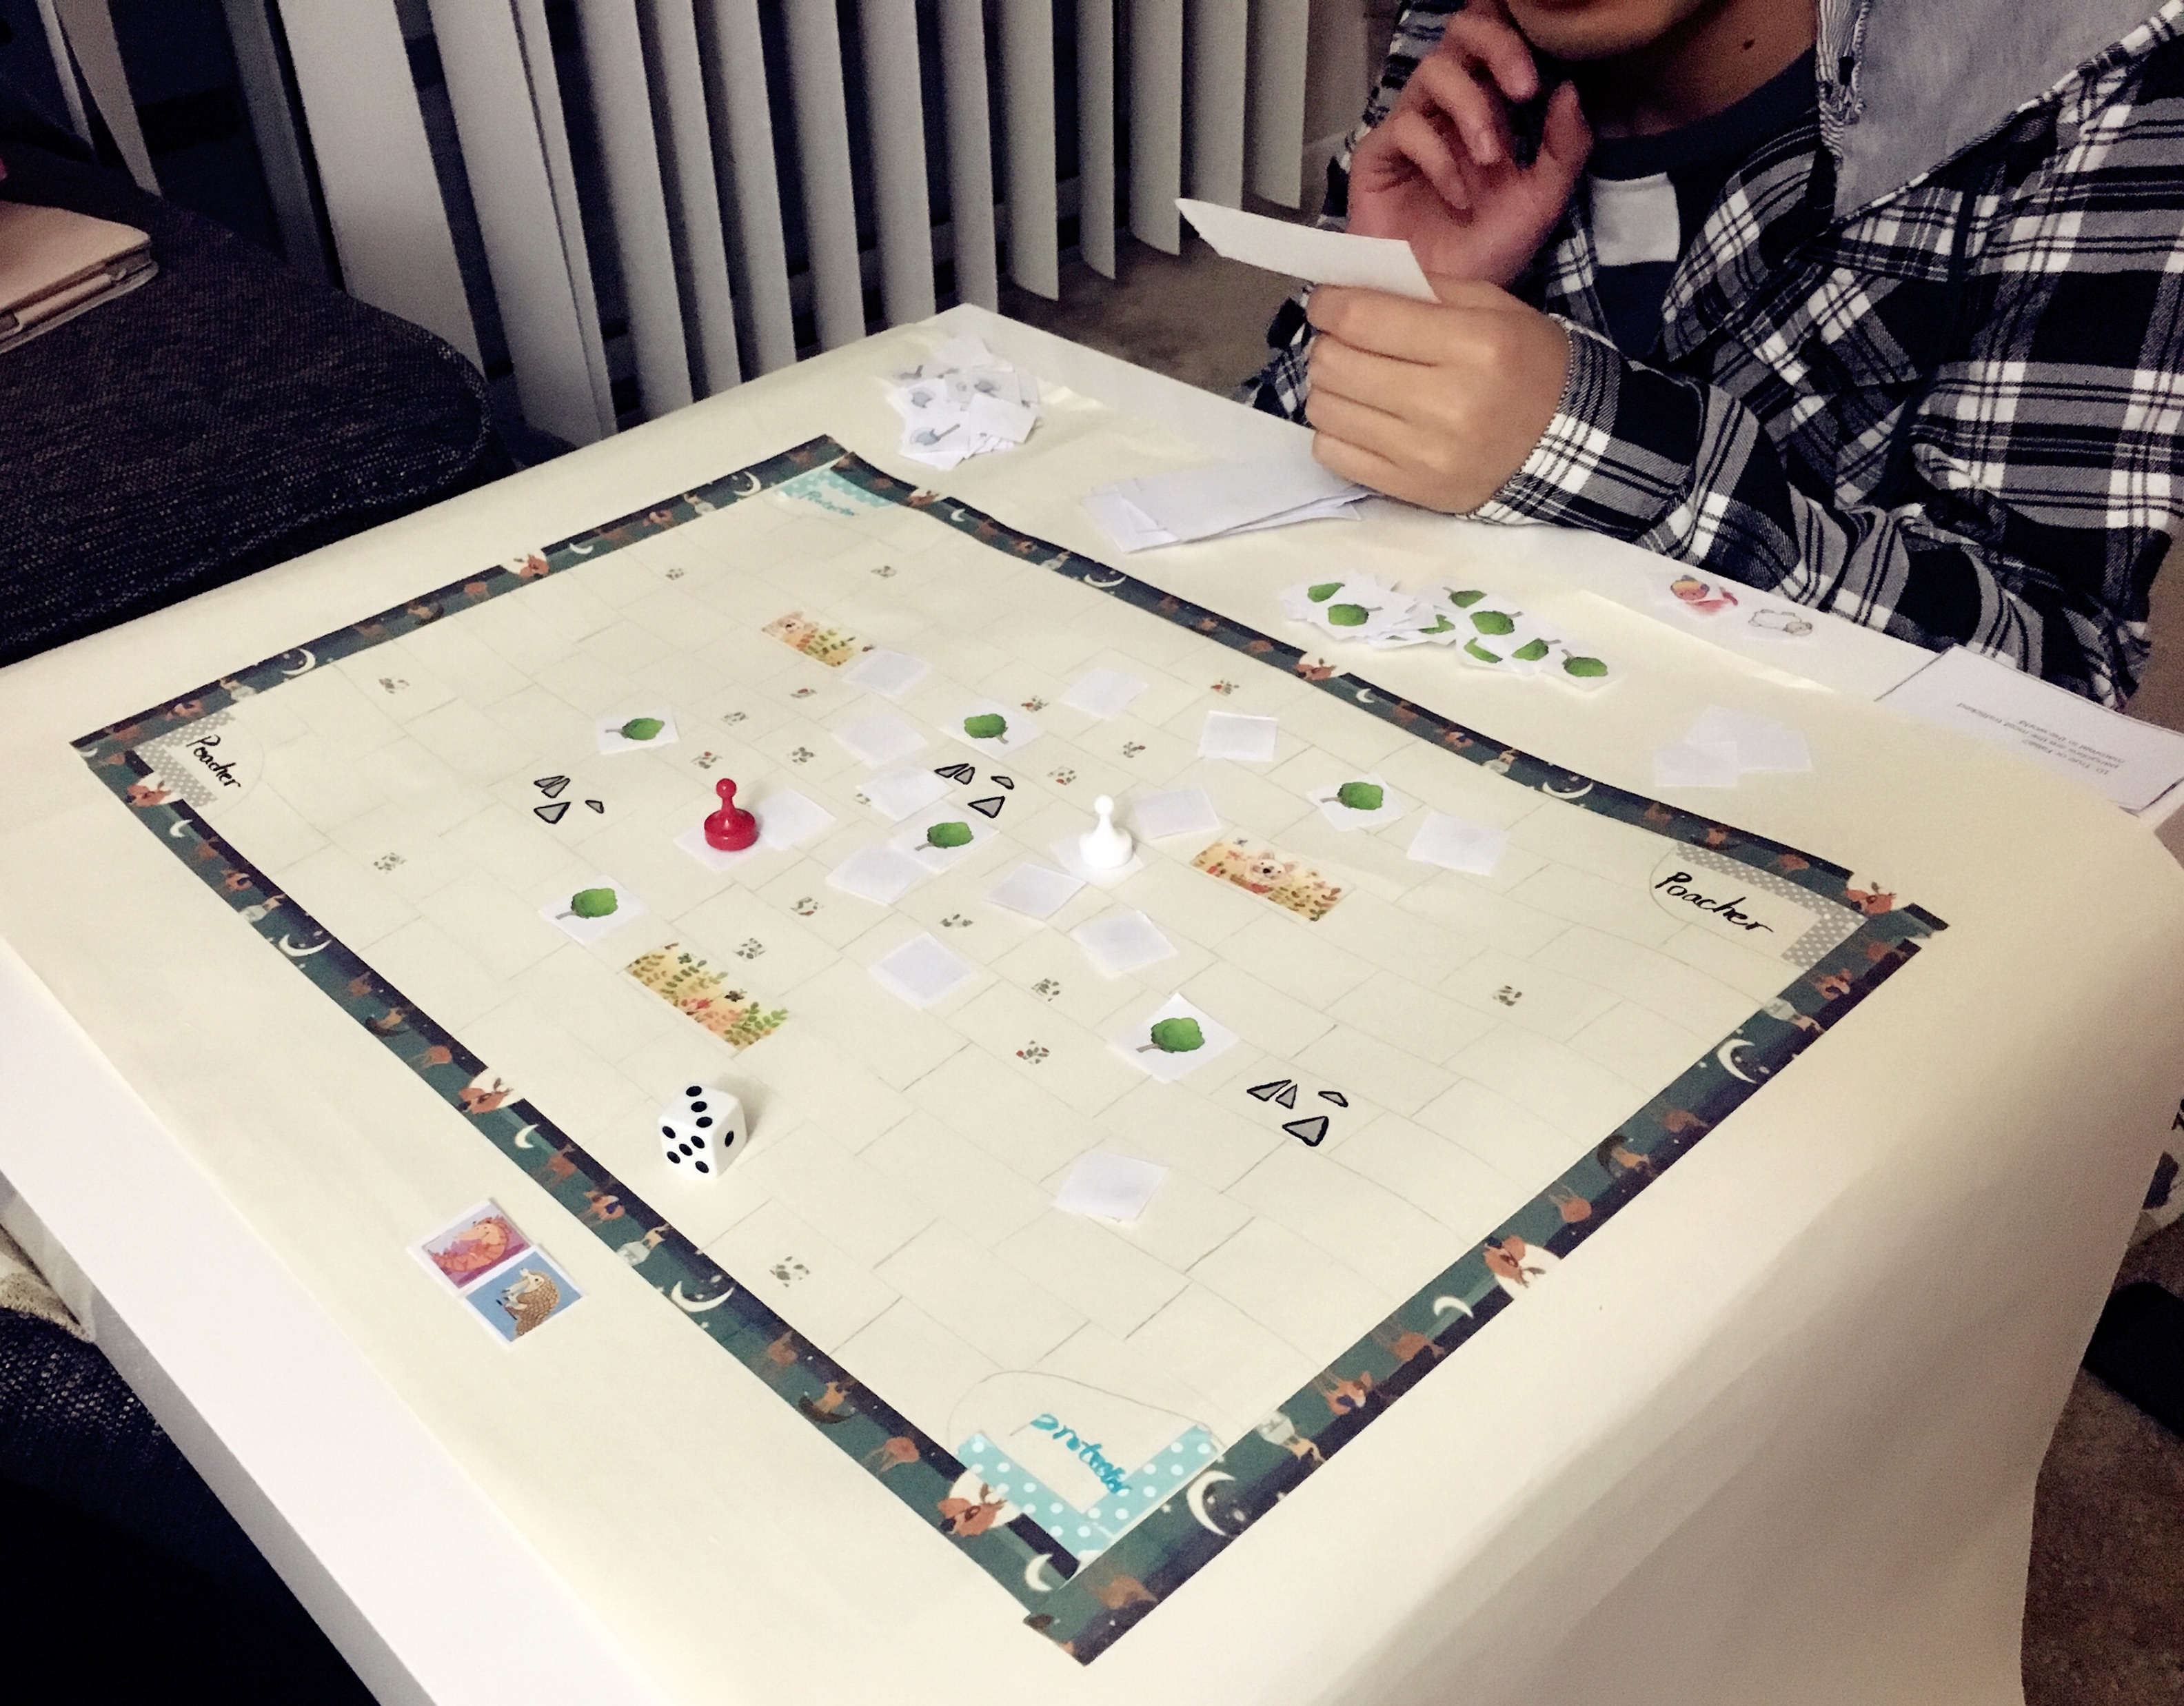
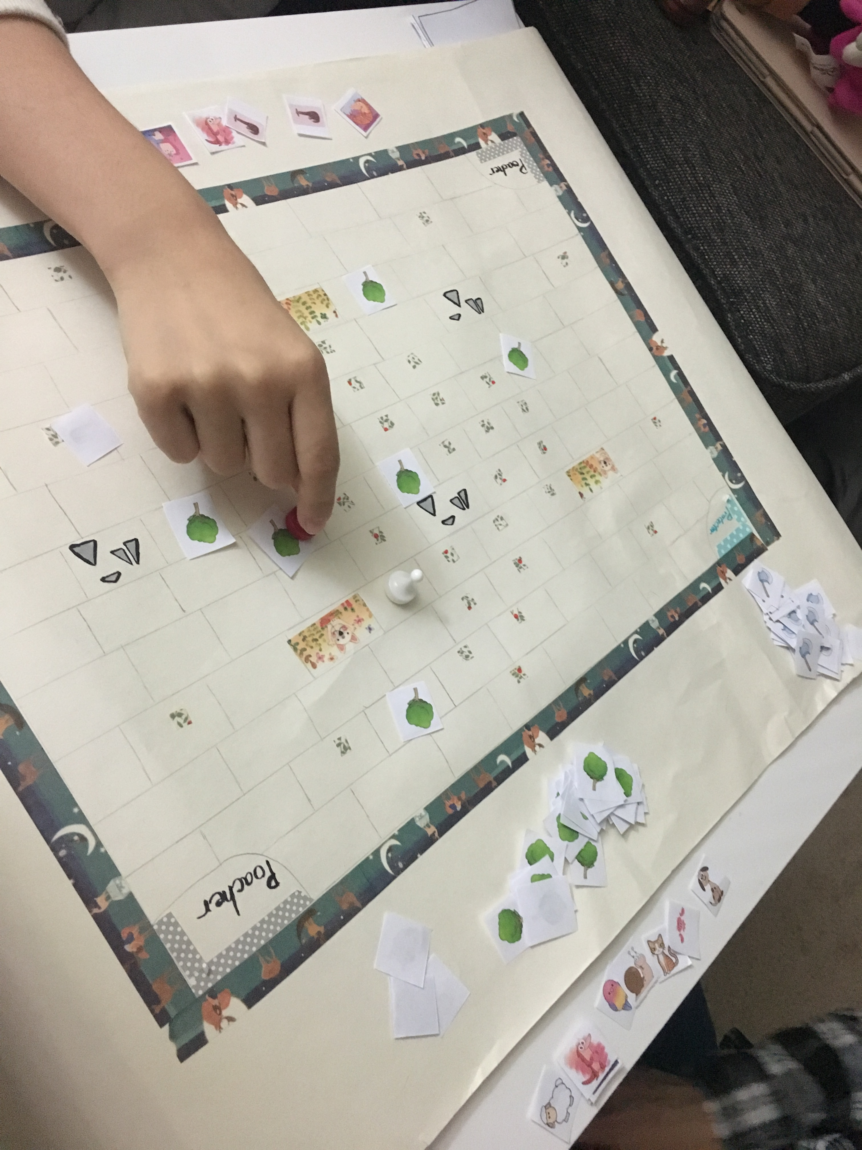
Playtesters
Pseudonym | Board game experience | Knowledge of pangolins | Interest in learning about pangolins | Interest in helping pangolins
Active Alex | Very much | Not very well | Maybe | Very much
Loving Lily | Somewhat | Somewhat | Very much | Very much

Slide 8
Playtest Summary
On March 26, 2017 playtesting was conducted with two Chinese students from Michigan State University
The participants included one woman and one man. A total of two rounds of the game were played.
The participants were asked to “think aloud” during the game
An observer shadowed the team to record the process
Players were asked to take a survey after the game

Slide 9
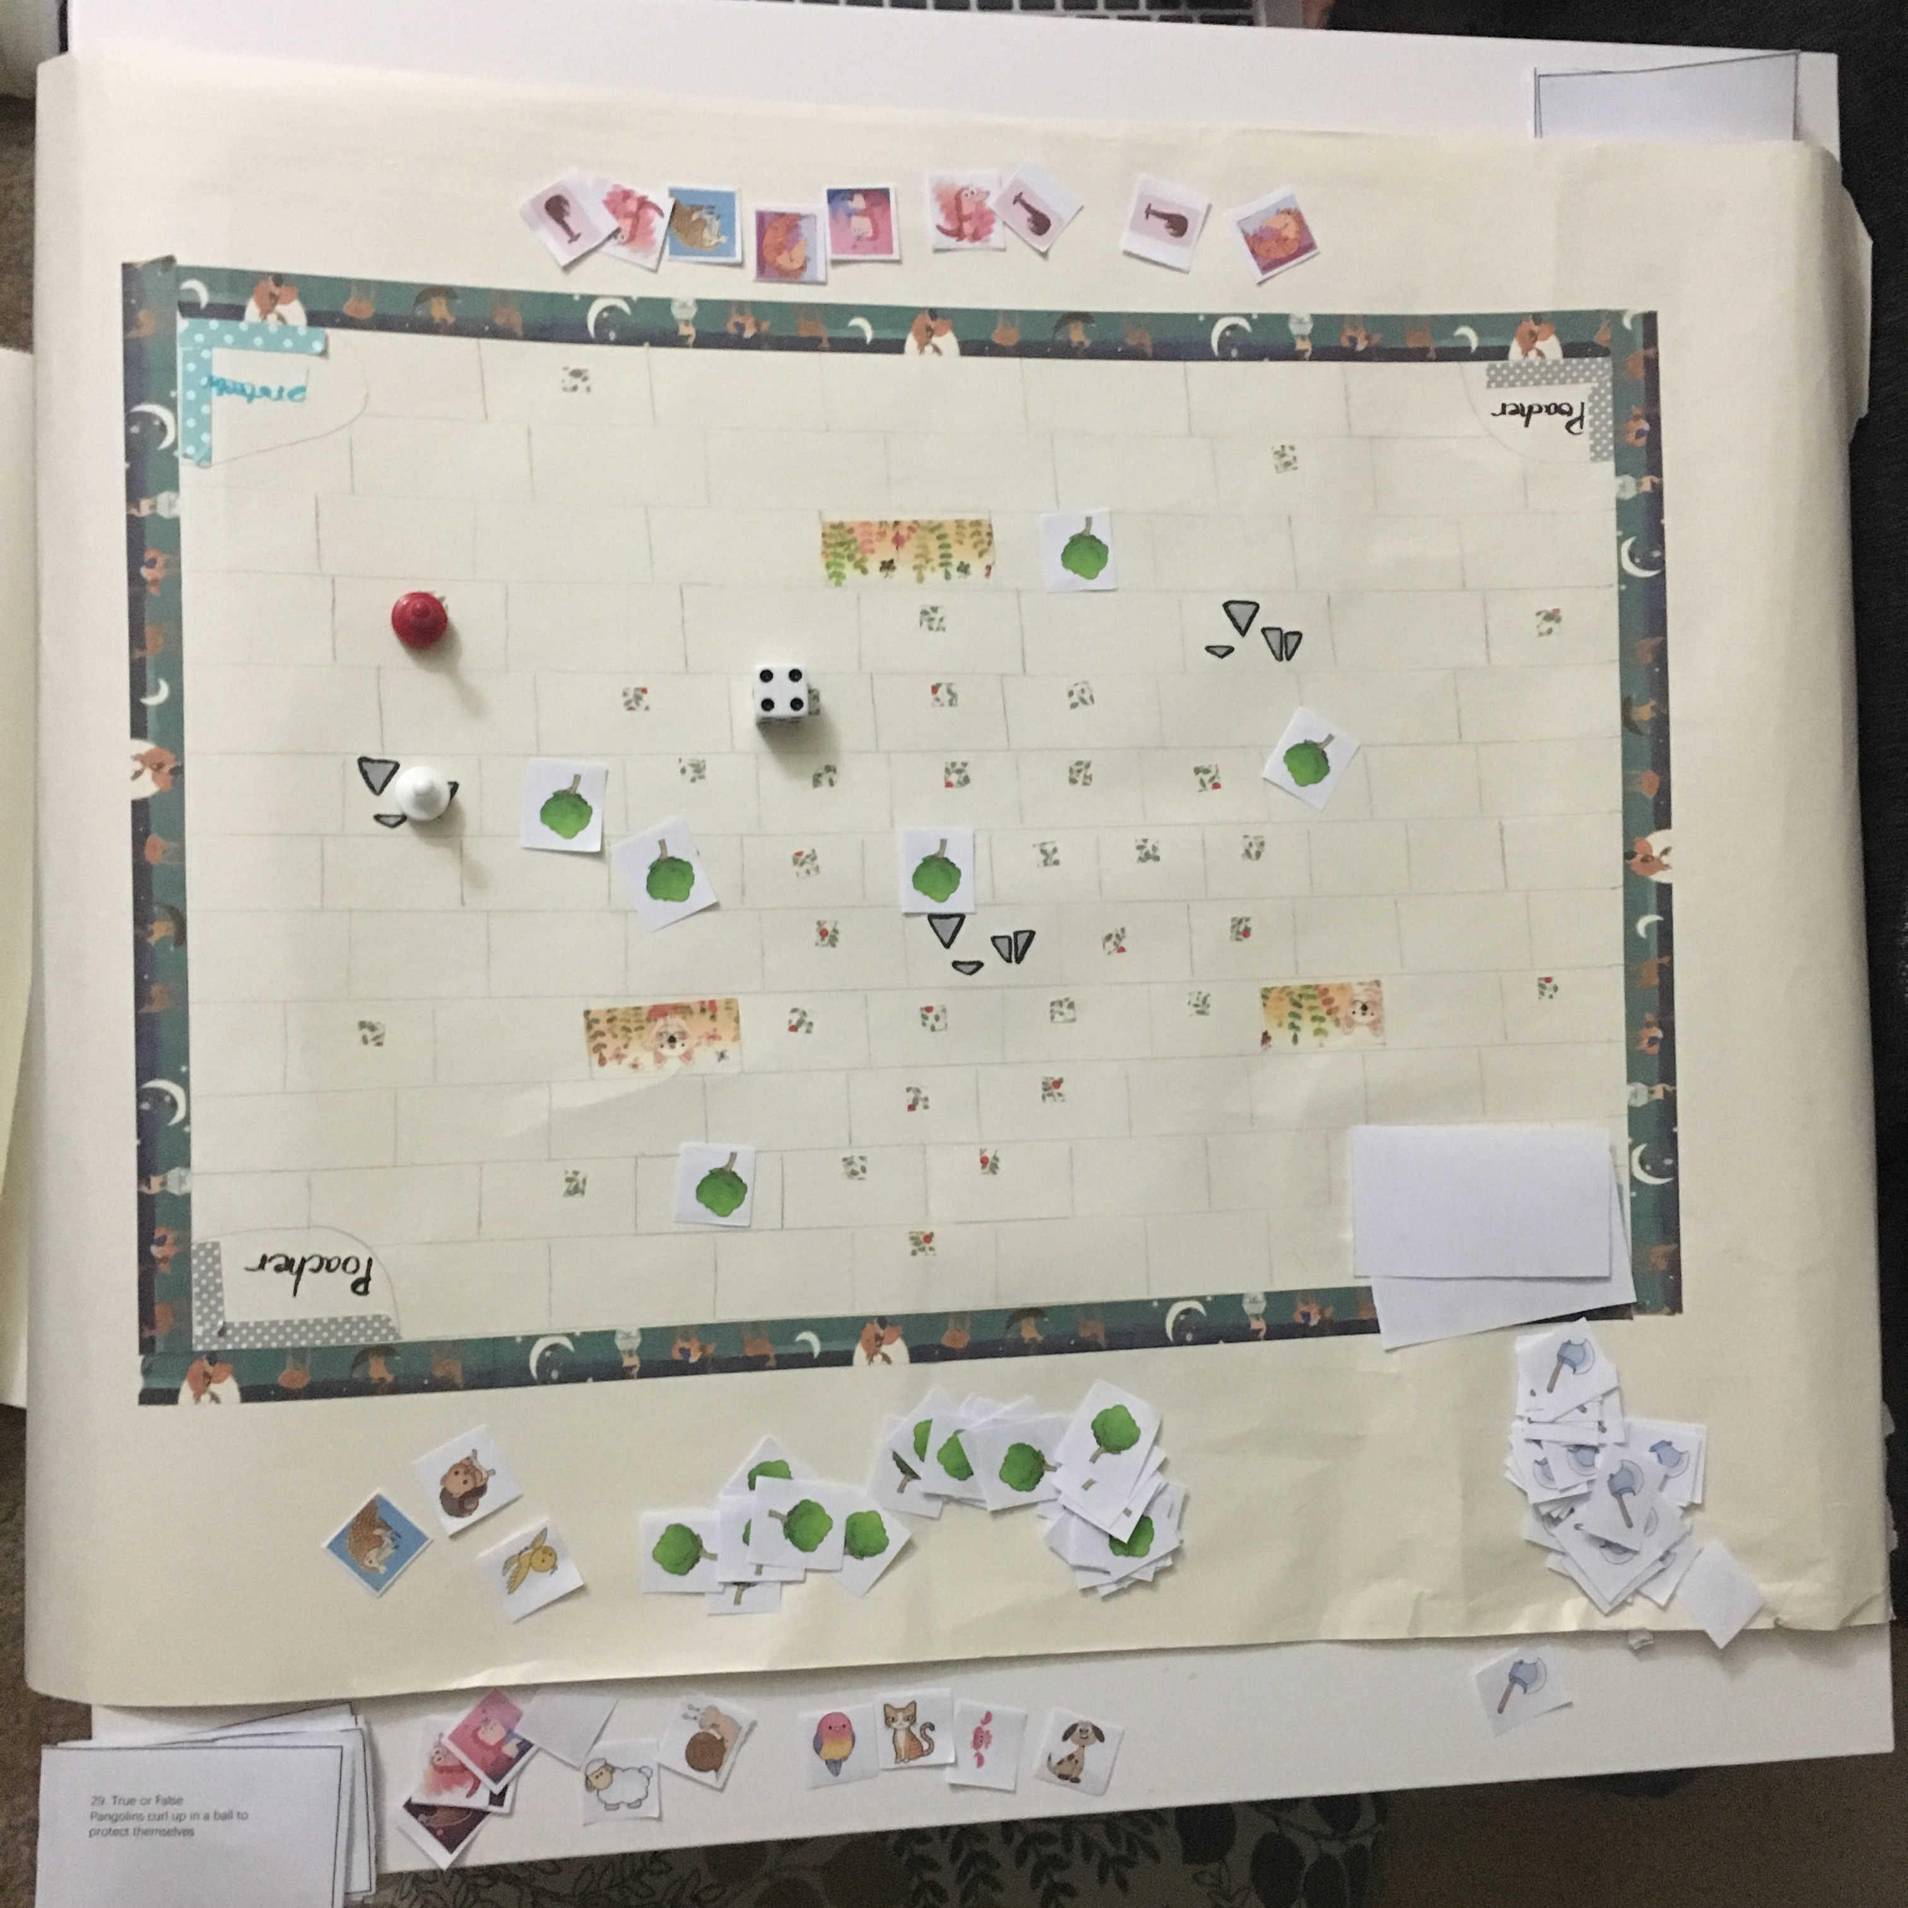
Playtest Summary
Game play time: 8:45pm~9:30pm (45min)
Role: Poacher— Active Alex; Protector— Loving Lily
Results: Protector won!
  Protector got 9 pangolins
  Poacher got 6 pangolins

Slide 10
Verbal feedbacks
Very fun!
I‘m surprised that pangolins can hang themselves from a tree!
It let me know what threats they are facing and what we can do to help.
It could be more fun if reducing the # of tokens and add more barriers into the map.

Slide 11
Key findings: Engaging & fun
After the players rolled the dice and decided the role. The poacher went into the mood of playing the game immediately, saying loudly “Finding pangolins!”. Then the protector laughed and said “No way!”. While playing the game, both players tended to think carefully and tried to win.
The game is fun because there is a clear competition
Both players showed interests when they saw the game map.
Some “stupid” options in the choice quiz made them laugh, such as “take pangolin home”.

Slide 12
Key findings:
Easy to learn & play
Players asked some questions at the beginning of the game, after that, both of them played smoothly.
Questions they asked:
  Why we need quiz cards?
  Can I land in a same square twice in a single turn?
  Is there time limit for answering quiz?
  Can poacher pass the tree or have to land in the tree to cut it？

Slide 13
Key findings:
Resonations & reflections
It is very interesting to see that the game reminded the protector of previous news she has seen about pangolins.
They were also surprised about some facts of pangolin they never knew before while answering quiz cards.
They found some quiz cards have similar questions but with different format, and they tried to answer by recalling the answer of last quiz cards, which is good for fostering players to remember the content.

Slide 14
Key findings: Game settings
Players quite like the prototypes’ graphic design and unknown animal tokens
But, some details need to be improved:
  During the whole game with 14 turns, players couldn’t land in a square with an animal token only for three times in total
  Pangolin tokens were too much, so players could always land in a square with an animal token
  Protectors seldom need to take effort to plant trees and poachers’ barriers didn’t increase

Slide 15
Key finding summary
Easy to learn and play
Fun and engaging
Help raise awareness of pangolins features, situation and the need of protecting actions
Some detailed settings need to be changed to make the game more challenging and fun

Slide 16
Design Recommendations
Reduce 20 unknown tokens to 15
Split the dots for animal tokens to foster players to separate the tokens
Add rules: no same square in a single turn; poachers can cut the tree as long as s/he passes through the square. They don’t have to land in the square.
Add more original trees to slow down the poacher
Add poacher’s traps in the map to hold the protectors in order to make the game more fair
Add time limit for quiz card to control the play time
Change the quiz cards’ size to make it easier to be read

Slide 17
Playtesting Report
March 29th
Thank you!
Yiqing Ling | MI 830

